Slide 1
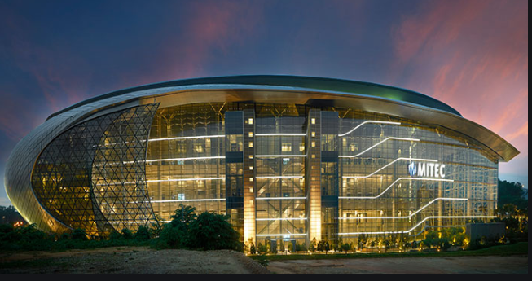
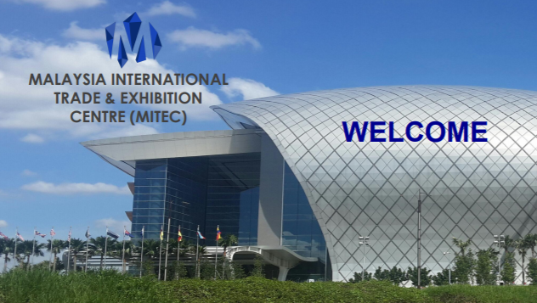
MALAYSIA INTERNATIONAL TRADE AND EXHIBITION CENTER
THE BUILDING IS COMMERCIAL

Slide 2
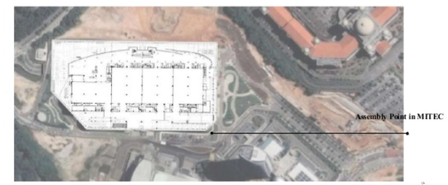
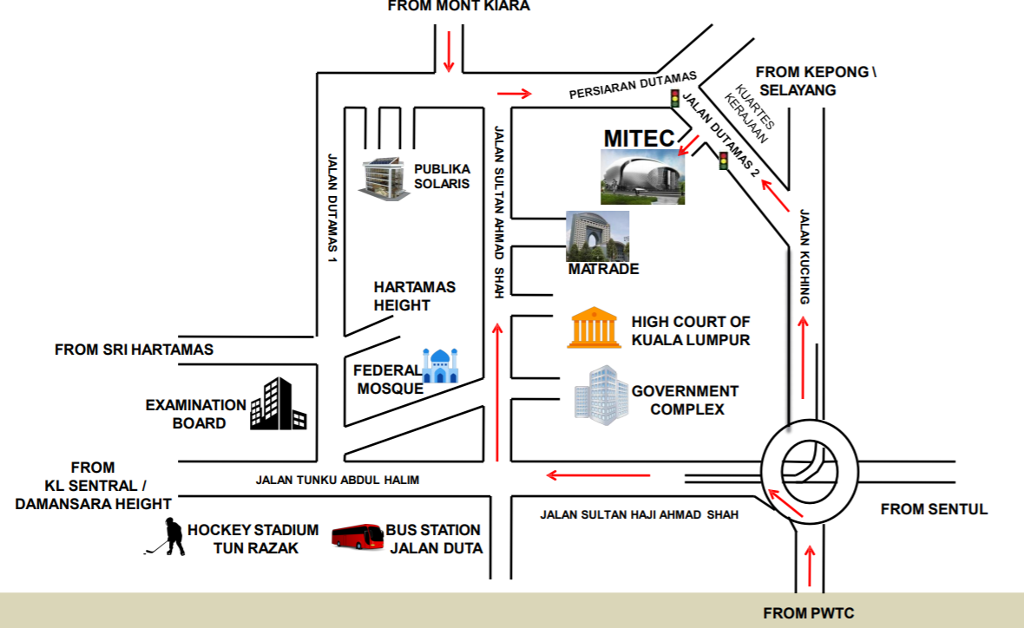
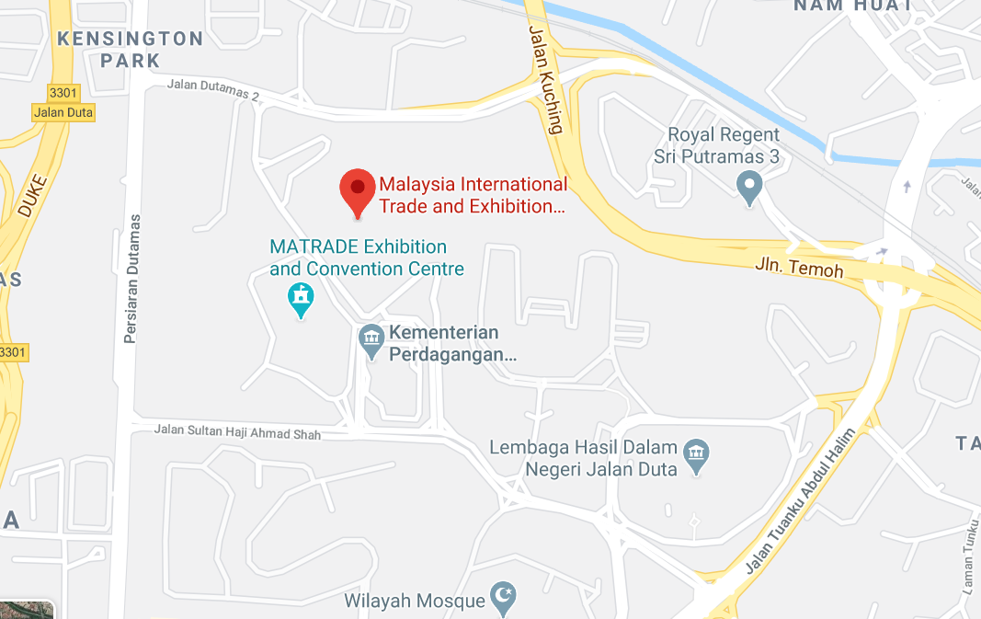
LOCATION OF THE BUILDING
MITEC,8,JALAN DUTAMAS2,KOMPLEKS KERAJAAN,50480 LUMPUR,WILAYAH PERSEKUTUAN
KUALA LUMPUR

Slide 3
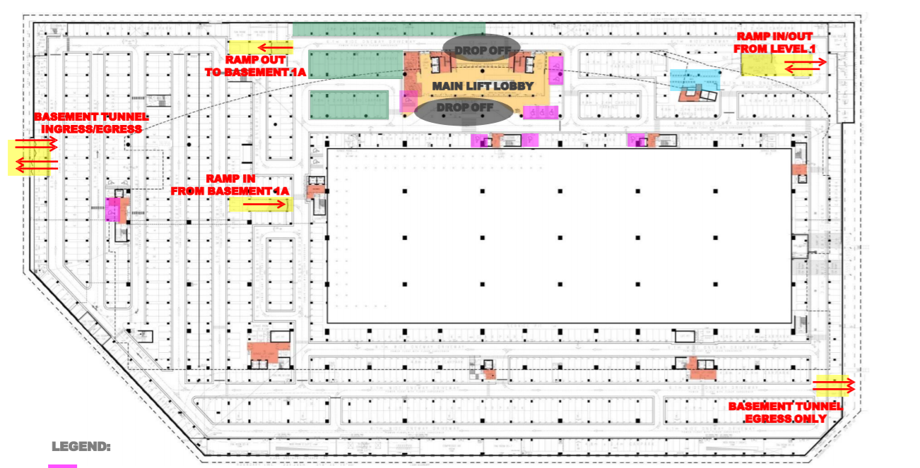

Slide 4
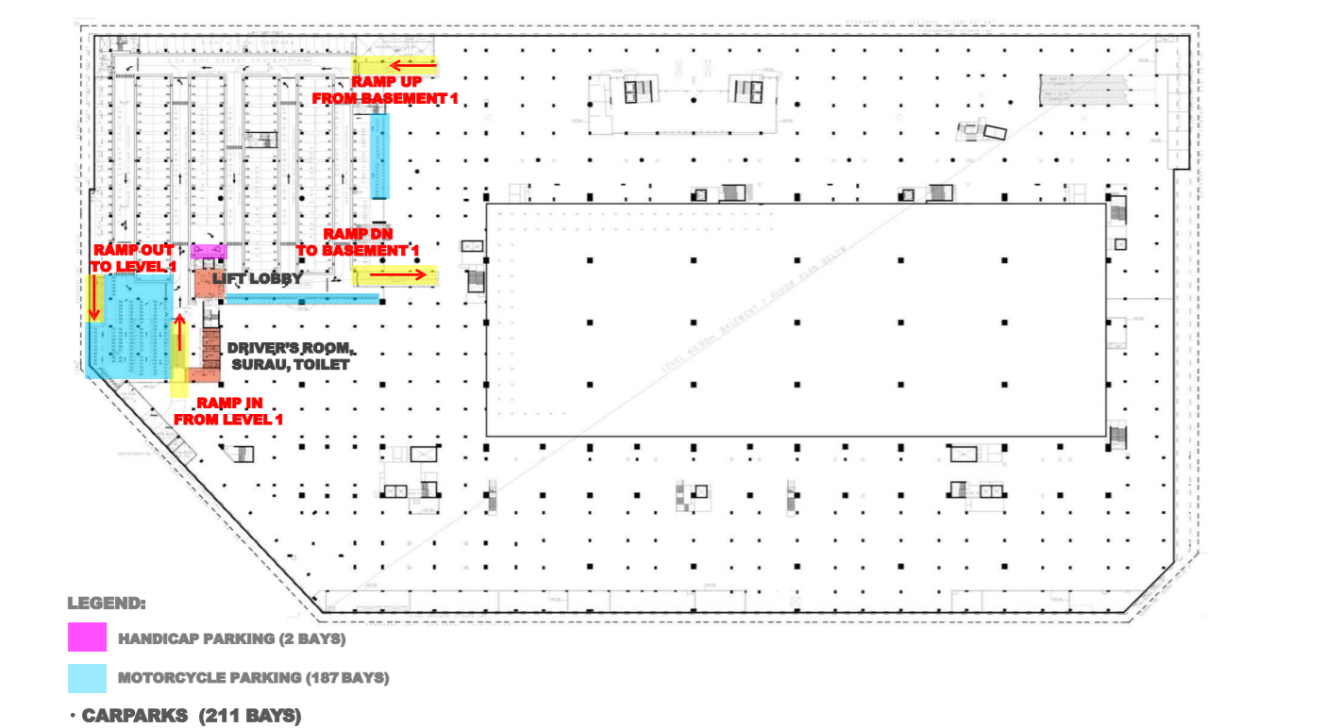

Slide 5
